Slide 1
Surface water flood risk management in London
Alex Nickson, Policy and programmes manager, climate change adaptation and water
Greater London Authority

Slide 2
…..so what is the GLA?
The Greater London Authority (GLA) is the regional government for London
Comprises an elected Mayor and an elected London Assembly
The Mayor
  has executive powers over the GLA Group
  is required to promote the health, wealth and social equality of Londoners
  is required to publish a range of statutory strategies
  has limited planning and development control powers
  is the ‘voice’ of London.
The London Assembly scrutinises the plans and activities of the Mayor and holds him to account.

Slide 3
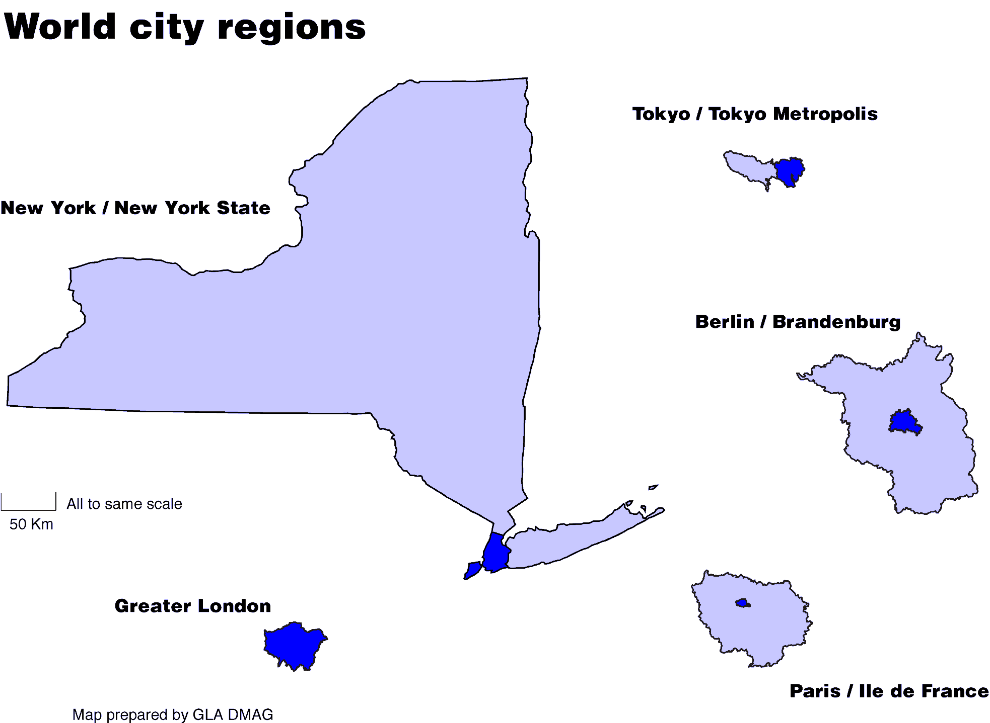
London as a ‘world city’

Slide 4
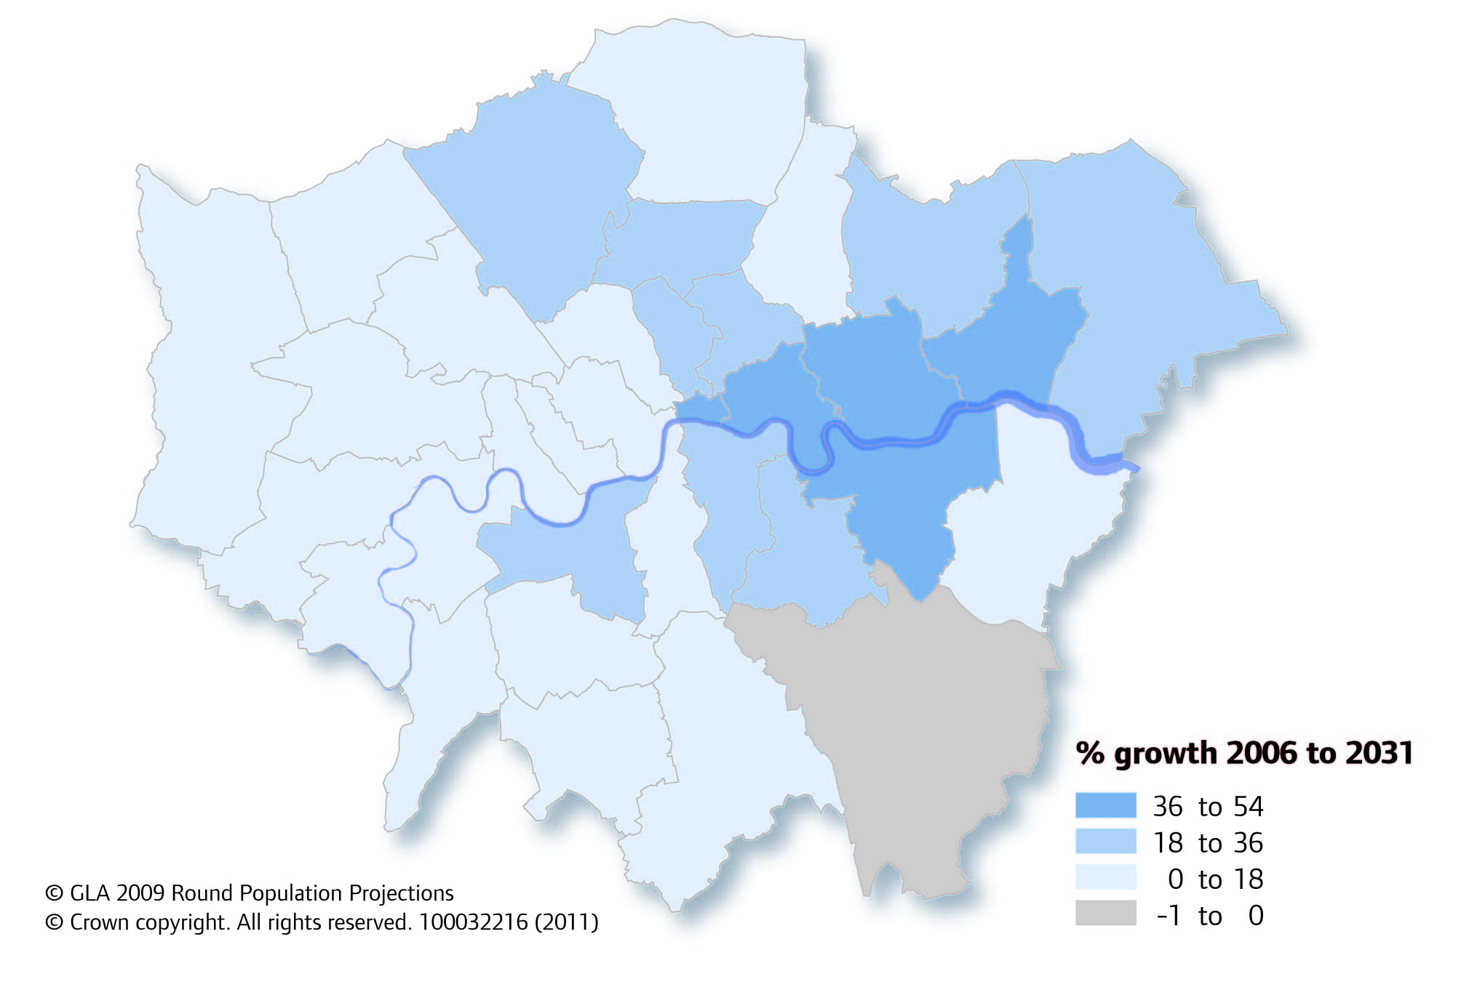
Distribution of population growth

Slide 5
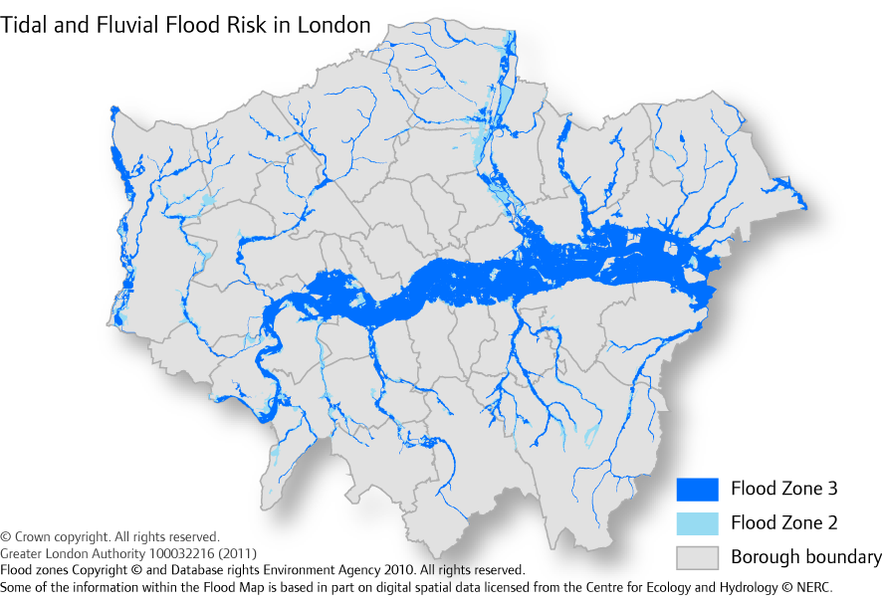
Tidal & fluvial flood risk in London

Slide 6
Why Drain London?
Early 2007, we identified surface water flood risk as a potential threat
  no ownership of risk
  no map of where might get wet
  fragmented responsibility for delivery
  low skills base outside consultancies
  33 boroughs, therefore 33 ways of working
Summer floods 2007 - £3bn insured losses
Government commissioned ‘Pitt Review’
Flood and Water Management Act
Notes:
14 of the Top 15 Settlements at risk in UK are LBs
28 of the 33 LBs are in the Top 50 Settlements

Slide 7
Drain London – How?
Tier 1
Scope project
Collate data
Build partnerships
Develop framework for effective working
Tier 2
Model risk in each borough
Identify ‘critical drainage areas’
Develop surface water management plan
  Build borough capacity and encourage ownership
Tier 3
Prioritise strategic vs local projects
Provide funding for priority projects
Implement some quick win demonstration projects
Initiate a ‘community flood plan’ programme

Slide 8
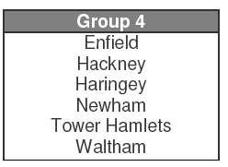
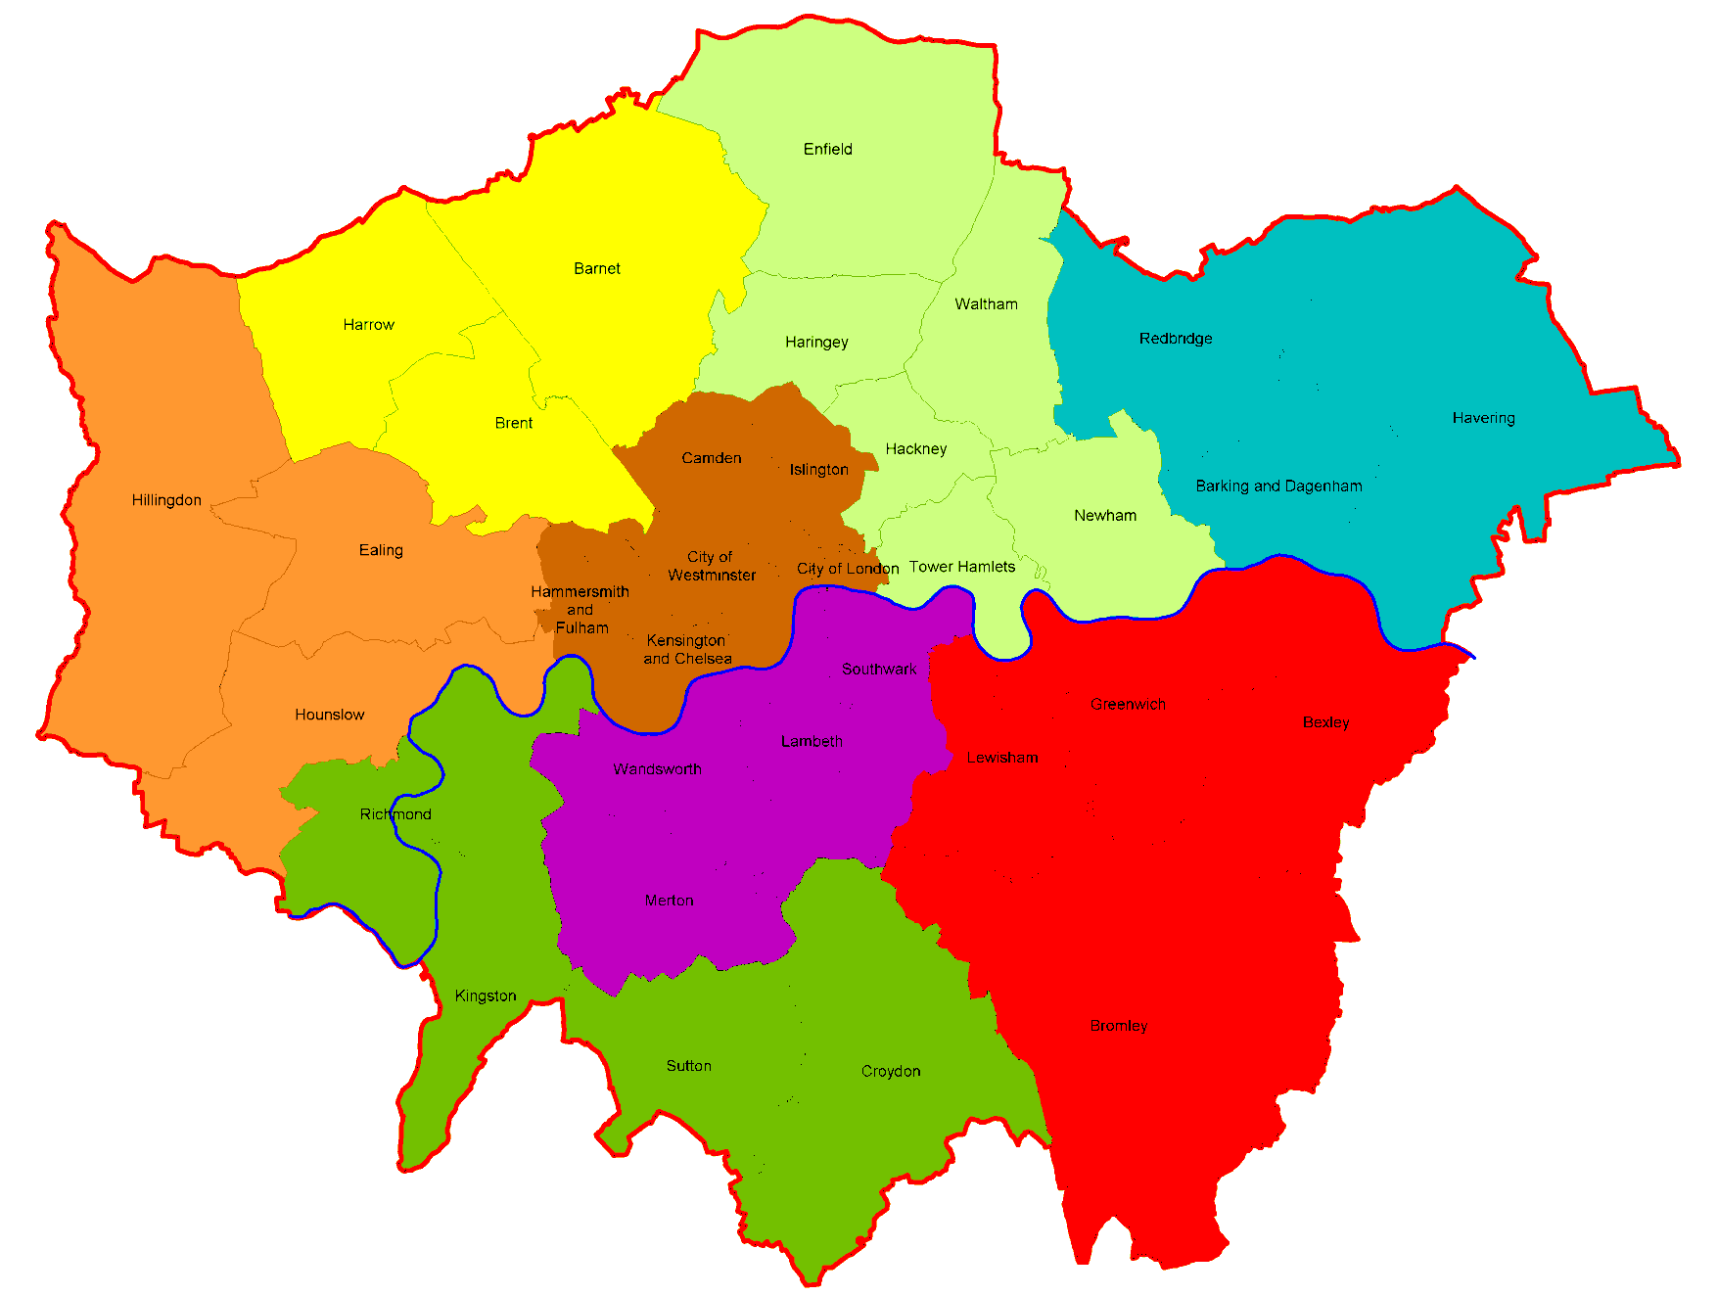
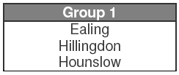
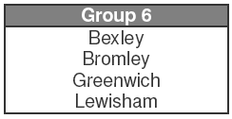
2
4
5
3
1
7
8
6

Slide 9
Surface water flood risk
1% AP + climate change
Source: Drain London

Slide 10
LLFAs – next steps
Flood Risk Regs 2009
Flood & Water Management Act 2010
Local Flood Risk Strategy & Management Plan
National level evidence
EA National Flood & Coastal Management Strategy
PPS 25
Regional level evidence
CFMP
RFRA
RBMP
TE2100
Local level evidence
PFRA
SWMP
SFRA could be built into a single document

Slide 11
Flood Depth – CDA Group4_009 1in 100year +CC
North Circular/A10 underpass
Watermill Lane – cul de sac
Containing Care home & NHS ancillary plant
North Middx Hosp

Slide 12
How will climate change increase flood risk?

Slide 13
Projecting future flood risk
Source : Ofwat (July 2010). Changes in the frequency of extreme rainfall for selected towns and cities. http://www.ofwat.gov.uk/sustainability/climatechange/rpt_com_met_rainfall.pdf
Notes:
Research undertaken by Met Office for Ogwat
Uses ensemble approach to assess uncertainty within natural variability of climate and climate change

Slide 14
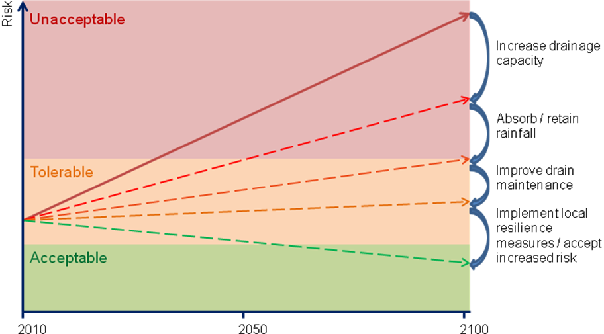
Closing the ‘adaptation gap’

Slide 15
Links between Drain London and Rain Gain
We have a ready-made Forum of key stakeholders
  “enabling environment” for testing the outputs from Rain Gain
  facilitate a full scale trial implementation in a borough
  joint capacity development at local government level
Potential collaboration in additional fund raising
We have good working relationship with national government

Slide 16
GLA will support improved rainfall monitoring over Greater London
Notes:
This picture is from the London Grid for Learning (http://weather.lgfl.org.uk/) – I don’t know if GLA has anything to do with it, but what GLA can do is to promote gathering of the existing information (from different sources) and also promote/support/favour the enlargement and improvement of the existing networks of raingauges so that better rainfall data is available for this area. If I’m not wrong, Lloyds and/or the London Climate Change Partnership were doing something for gathering the weather info available for Greater London – you could mention this and similar initiatives.
Having rainfall ground measurements (i.e. from raingauges) is essential for improving rainfall estimates. In general, radars tend to underestimate the peaks of the storms; they are good at providing spatially distributed information for a given area, but the “quantitative” part may not be so accurate some times. If data from a dense and quality controlled network of raingauges is available, it can be merged with radar data and the final rainfall estimates can be significantly improved. This is very important when high resolution is required and when you want to get the peak of local storms right. Also, it would allow identifying rainfall cells within London and obtaining data which would enable better modelling and planning for reduction/management of flood risk.

Slide 17
GLA will promote and support link with other stakeholders and implementation of the project deliverables through the Drain London network
Notes:
This is an organi/sociogram of the stakeholders involved in urban flood risk management in Redbridge (our case study for a previous EU project and also for RainGain).
In this diagram each band of the “rainbow” corresponds to one stakeholder category: the inner band of the rainbow corresponds to the Local Champions, who gather most flooding information and coordinate flood risk and emergency management, and it is from this band that information flows to the outer bands (to the Primary, Secondary and Tertiary stakeholders). You can find a more complete description of this diagram in this link: http://hikm.ihe.nl/diane_cm/cranbrook/index.php?option=com_wrapper&view=wrapper&Itemid=34
This simply illustrates the people involved in FRM, their role in it and their interactions. You can even see the GLA at the bottom right corner. Given the role of the GLA, you could help us in approaching many of the stakeholders groups shown in this diagram, so that we can enhance flood resilience at all levels, taking into account the characteristics, interests, etc. of different groups of stakeholders.

Slide 18
Contact details:
Alex Nickson
GLA
Alex.Nickson@london.gov.uk
+44 (0)207 983 4322

